Slide 1
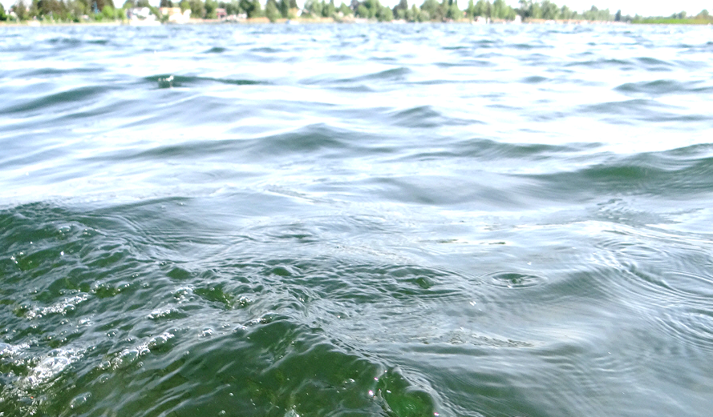


Katrin Teubner
Katrin Teubner
New Emphasis on Water Clarity
as Socio-Ecological Indicator for Urban Water
– A SHORT ILLUSTRATION
Univ.-Doz. Dr. Katrin Teubner www.lakeriver.at
Katrin Teubner, Irene E. Teubner, Karin Pall, Wilfried Kabas,
Monica Tolotti, Thomas Ofenböck, Martin T. Dokulil
43rd IAD-conference, Aueninstitut Neuburg a.d. Donau,
Germany: Rivers and Floodplains in the Anthropocene – Upcoming
Challenges in the Danube River Basin, 9 – 11 June 2021

Slide 2
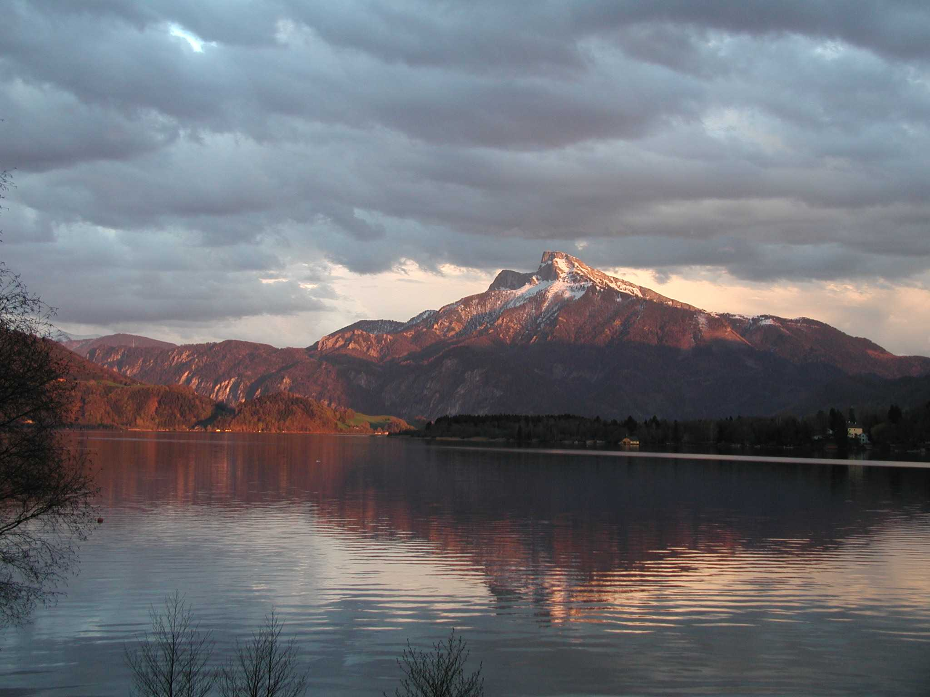
43rd IAD-conference, June 2021
Measuring Water Transparency by light attenuation under water:
2
Univ.-Doz. Dr. Katrin Teubner www.lakeriver.at
1 Secchi Disk
2 Light Sensor
1
from FBA by Irene Teubner (2006)

Slide 3
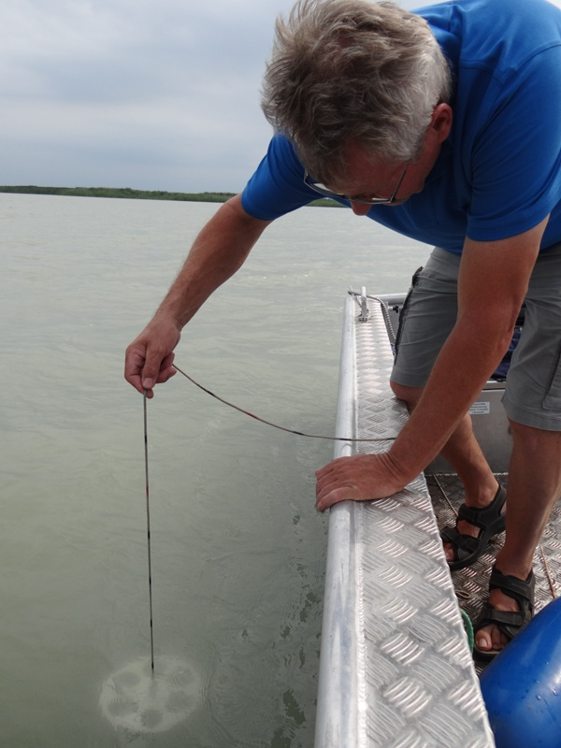
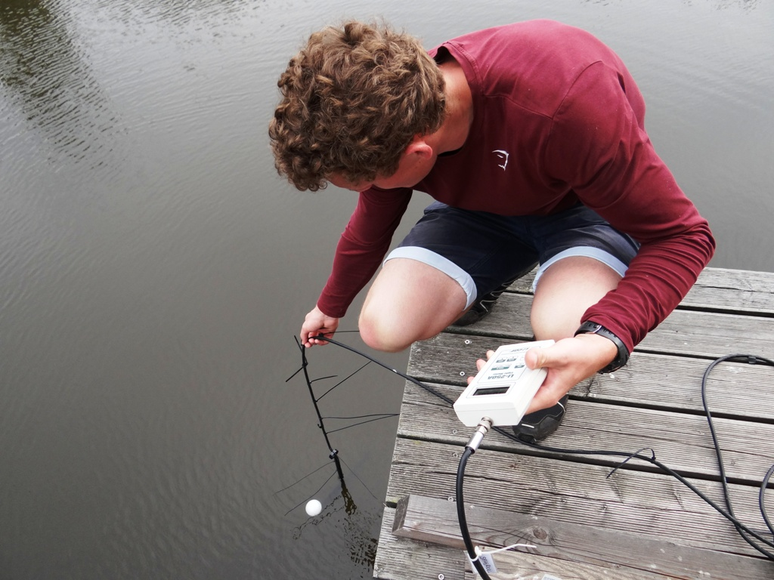
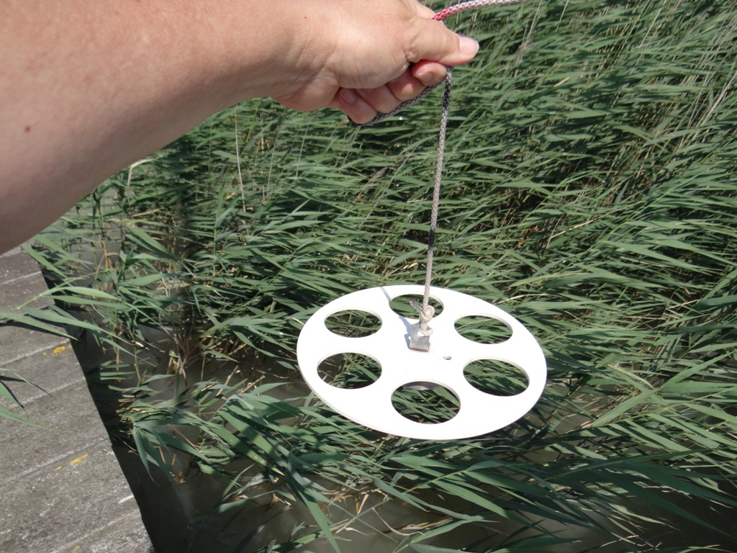
Measuring Water Transparency by light attenuation under water:
https://www.fishersci.ca/shop/products/united-scientific-secchi-disk/s12871
Univ.-Doz. Dr. Katrin Teubner www.lakeriver.at
Photo: K Teubner
Photo: K Teubner
Photo: K Teubner
1 Secchi Disk
2 Light Sensor
43rd IAD-conference, June 2021

Slide 4
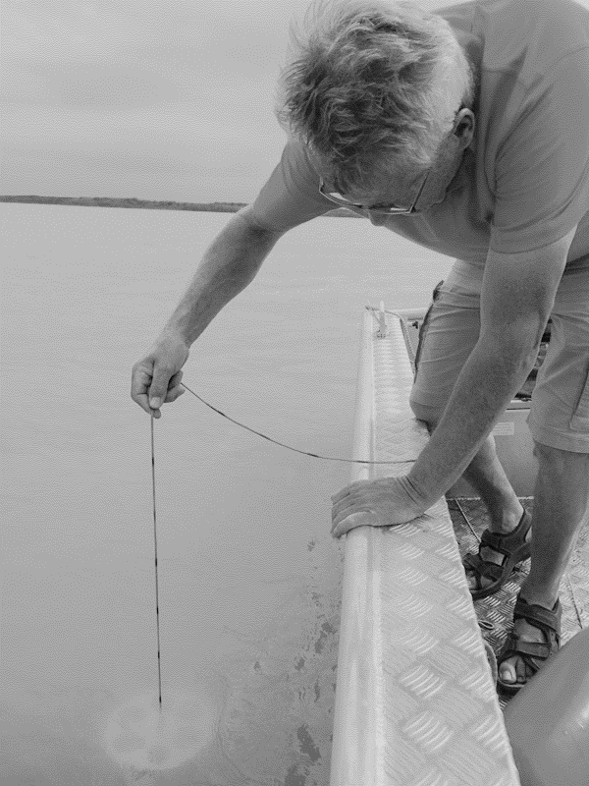
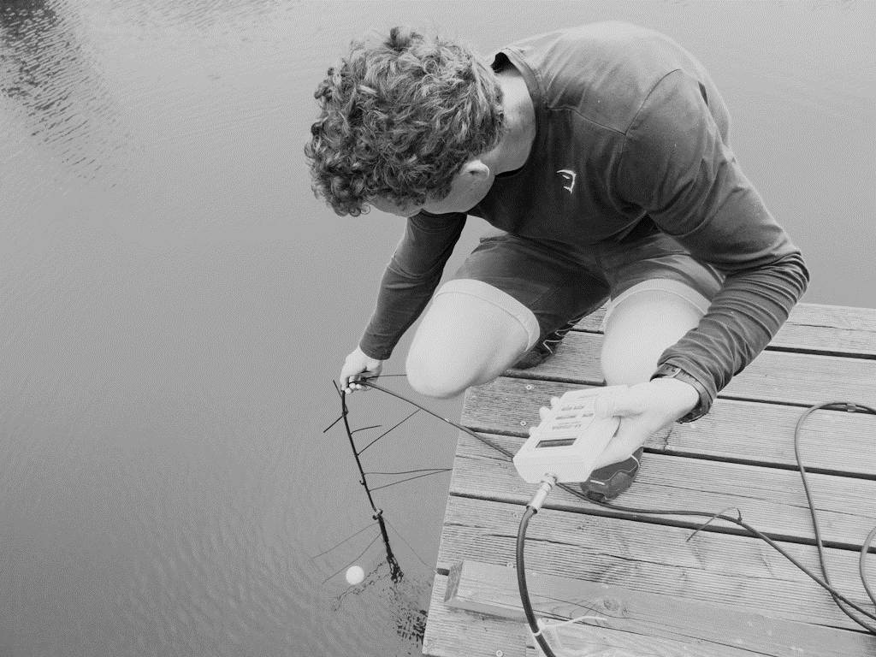
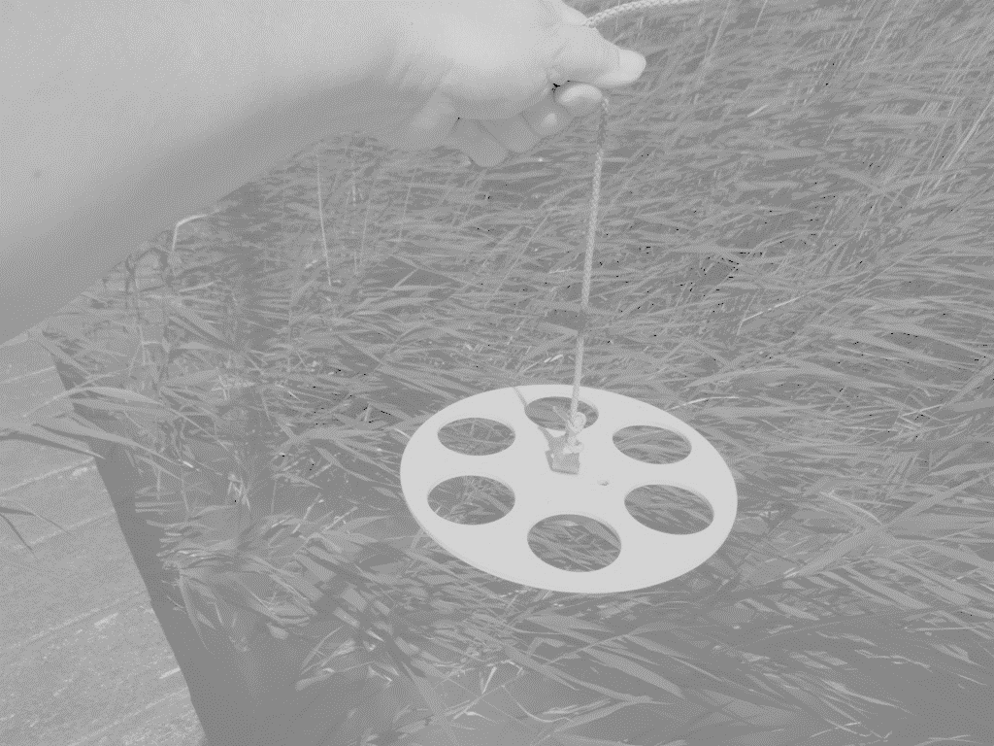
Measuring Water Transparency by light attenuation under water:
https://www.fishersci.ca/shop/products/united-scientific-secchi-disk/s12871
Black-and-white Secchi Disk
Univ.-Doz. Dr. Katrin Teubner www.lakeriver.at
Photo: K Teubner
Photo: K Teubner
Photo: K Teubner
1 Secchi Disk
2 Light Sensor
43rd IAD-conference, June 2021

Slide 5
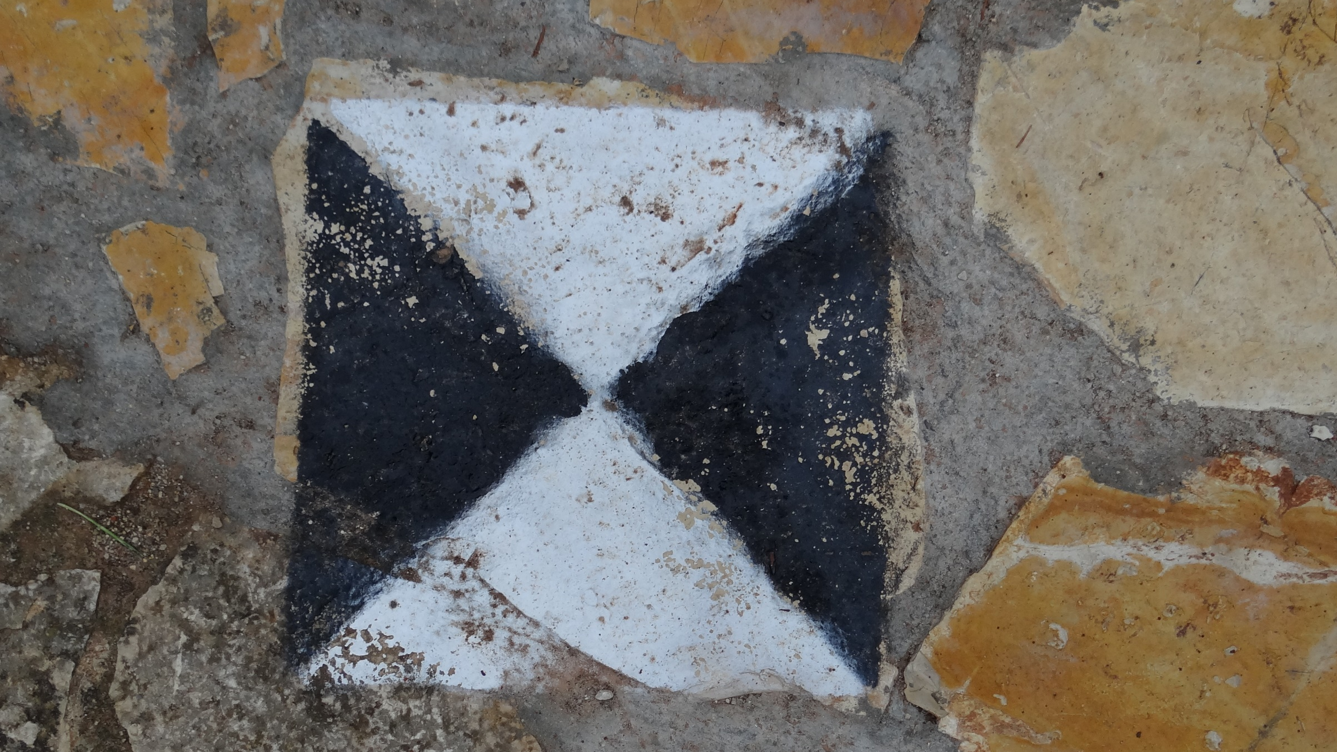

Univ.-Doz. Dr. Katrin Teubner www.lakeriver.at
Photo: K Teubner
43rd IAD-conference, June 2021

Slide 6
…thinking about such a disk,
that begs the question:
Who was the first measuring water visibility by lowering items under water, like a disk – and for what this is good for?
Univ.-Doz. Dr. Katrin Teubner www.lakeriver.at
43rd IAD-conference, June 2021

Slide 7
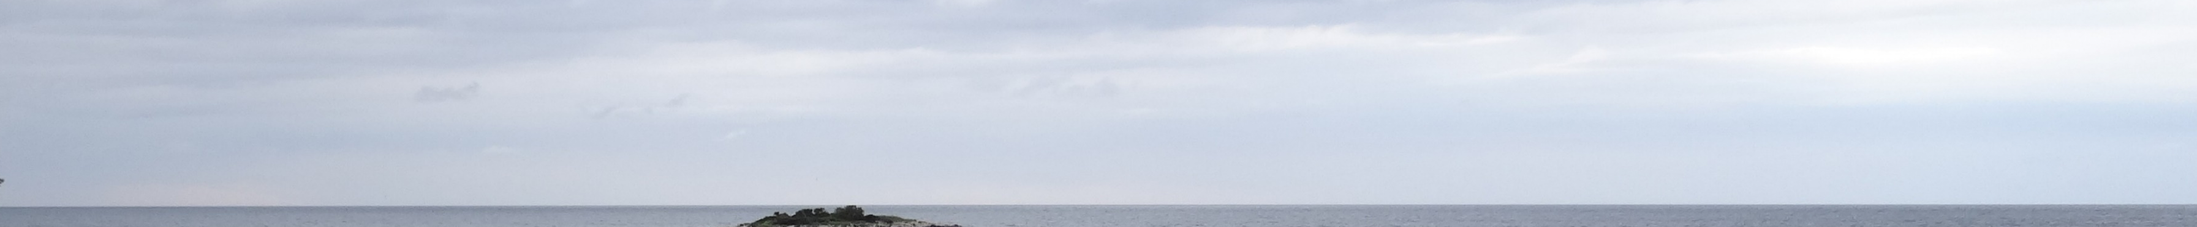
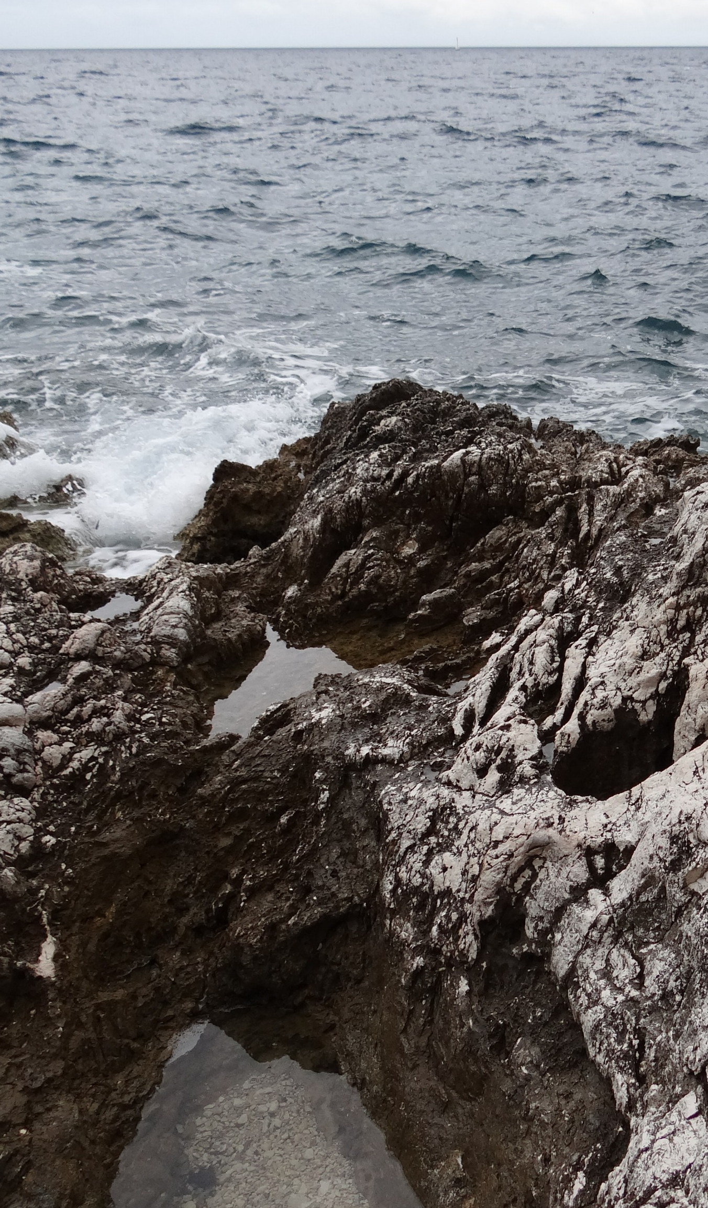
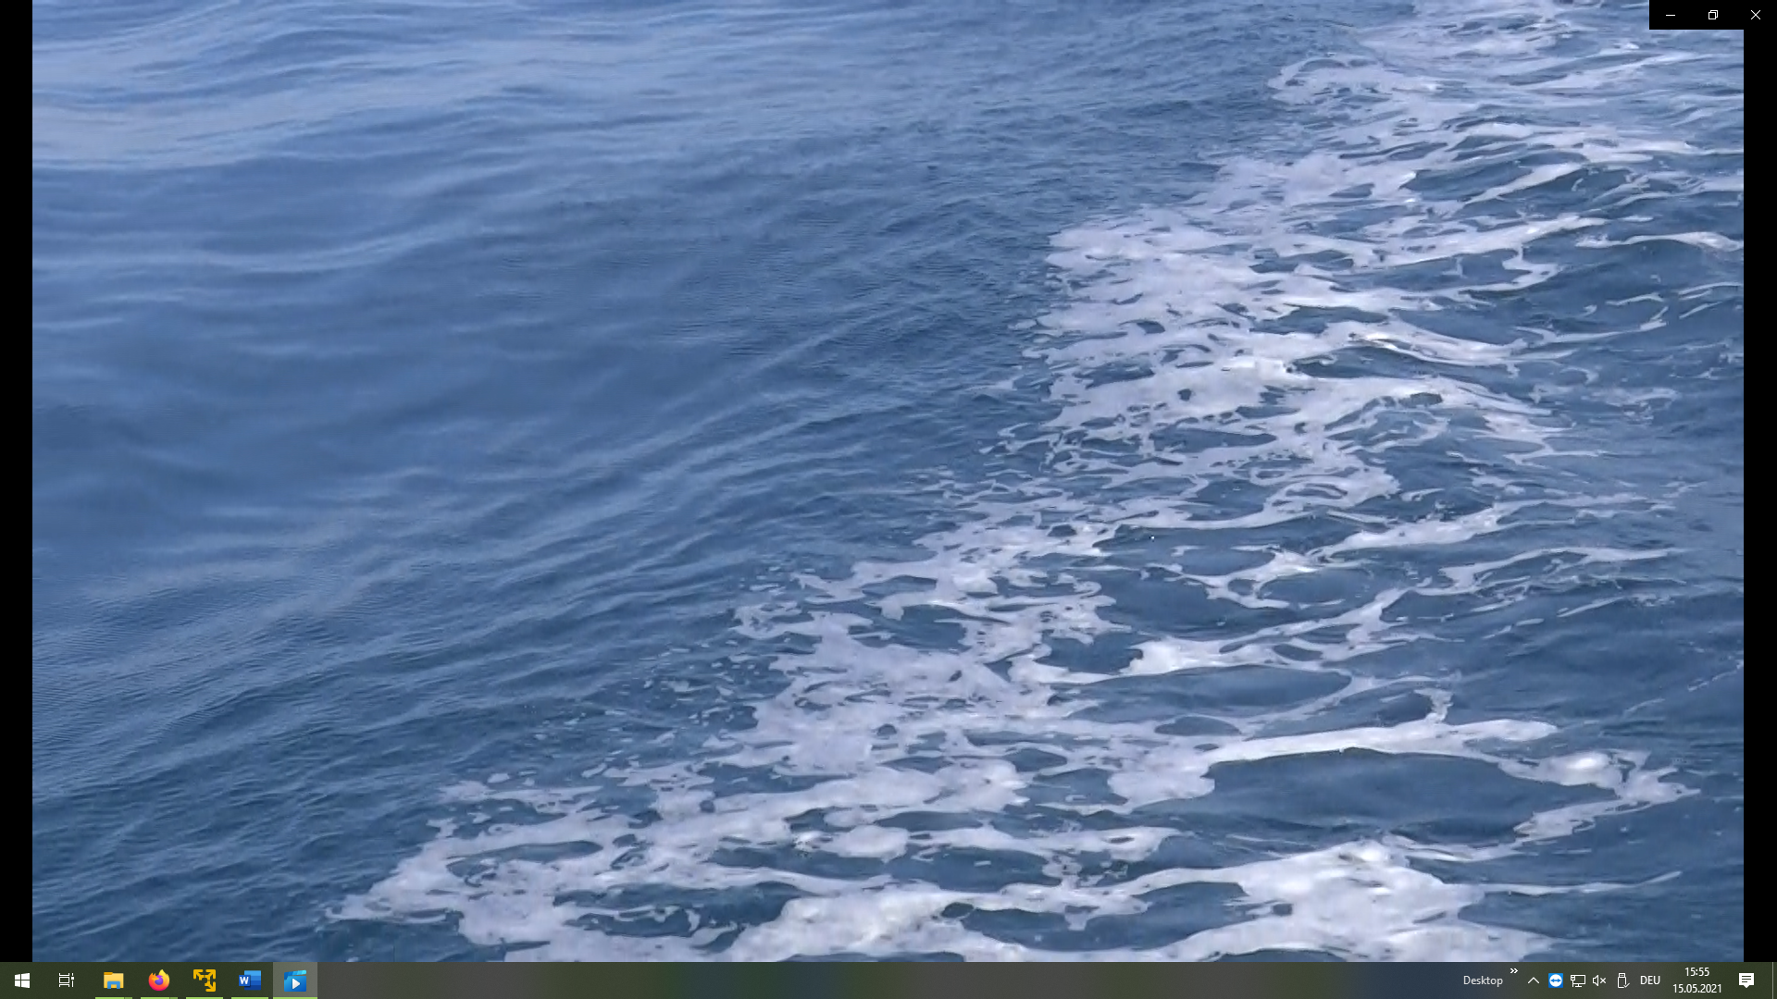
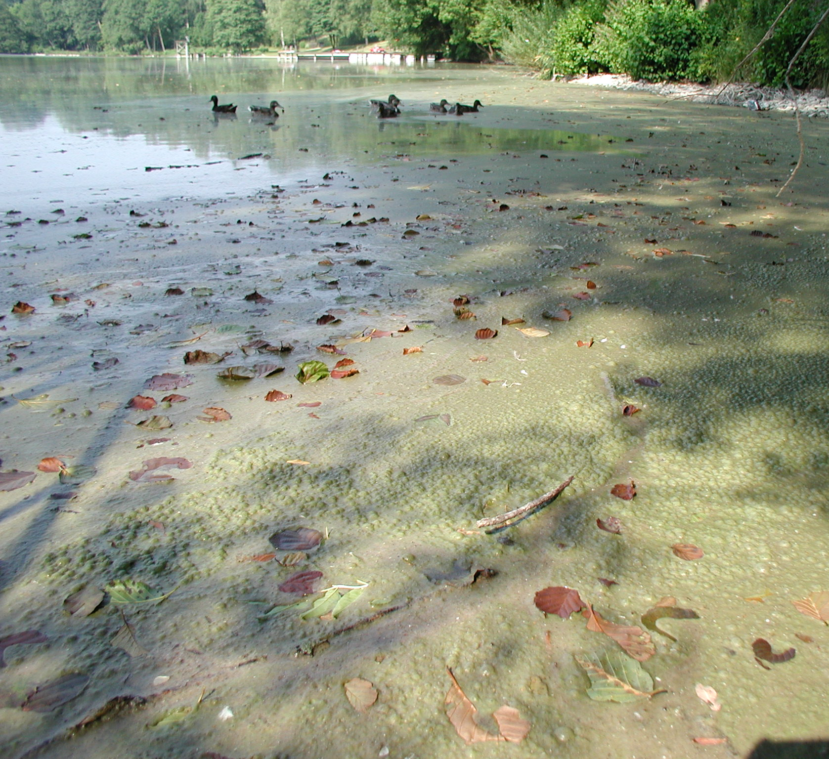
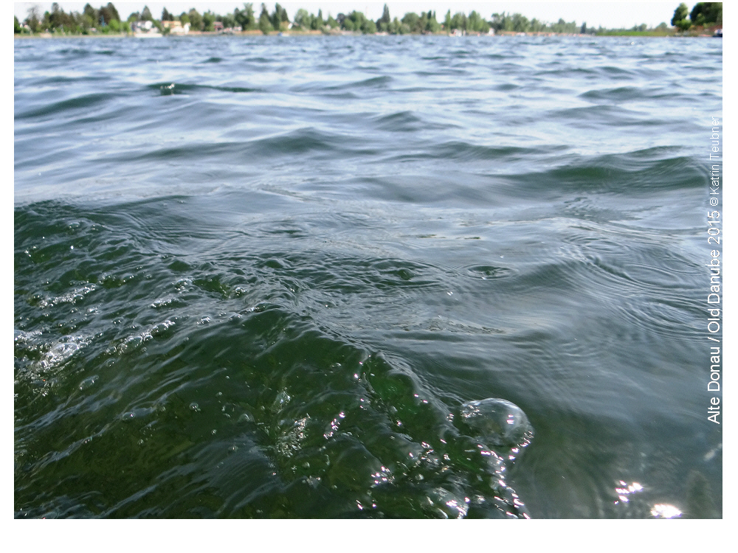
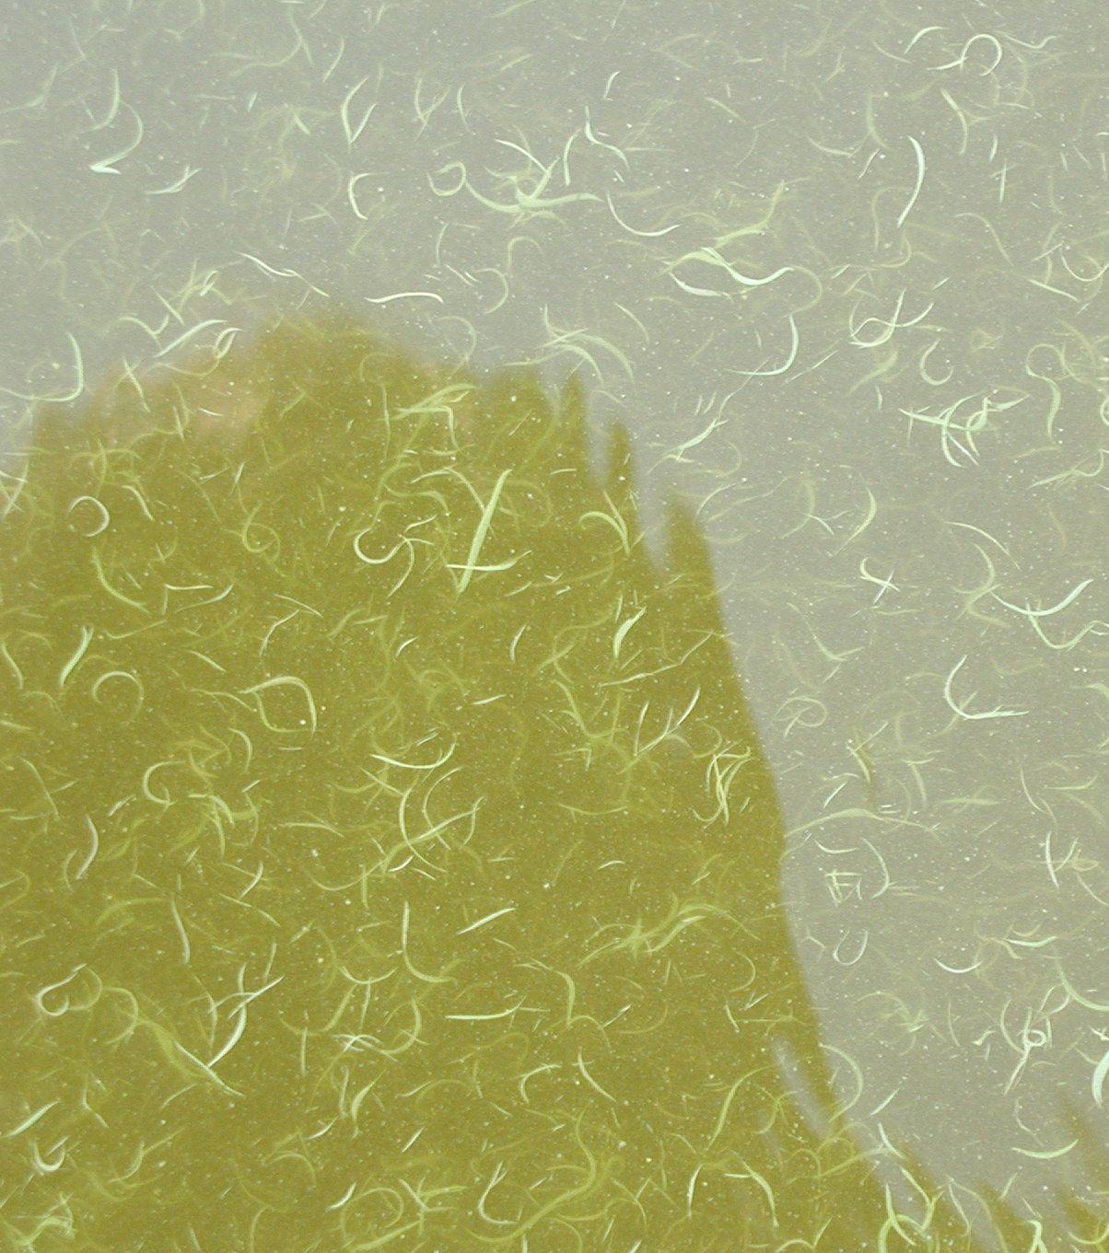
1815
1866
1892/1893
1968
1995
2000
2002
2005
2020
Marine environment,
WT measured by
Lowering items under-
water as e.g. a disc
Marine,
Secchi-Disc
depth method
established
Lake Secchi Depth,
Limnology founded
as „oceanography
of lakes“ (Forel, 1892)
WT used for trophic classifi-
cation schemes, Eutrophication
mirrored by low WT due to algal
turbidity (Vollenweider, 1968)
Ecosystem health
(Rapport, 1995)
Anthropocene
(Crutzen, 2002)
WT as socio-
ecological
indicator
(Teubner, 2020)
Ecosystem services
(MEA, 2005)
WFD (EC, 2000)
1815 VonKotzebue
(in Krümmel,1886)
Secchi, 1866
Forel, 1893
Vollenweider, 1968
Carlson, 1977
Forsberg & Ryding, 1980
Nürnberg, 1996
Teubner et al., 2020
Univ.-Doz. Dr. Katrin Teubner www.lakeriver.at
Measuring WT as physico-optical
property estimating underwater
distances in coastal waters aimed
at safe marine navigation
Biological perspective of WT in freshwaters by
assessing light utilisation of algae building up biomass,
which in turn causes algal turbidity and reduces WT,
focus on nutrient enrichment by eutrophication that
flourishes algal growth and dampens WT
WT in view of ecosystem
health assessment, satisfying WT
stands for overall success in case of
sustained lake restauration aimed
at delivering ecosystem services
from: Teubner et al. 2021, extended abstract, 43rd IAD-conference

Slide 8
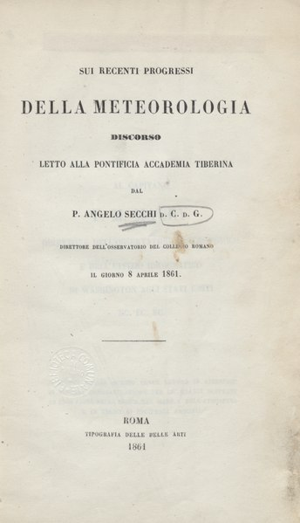
Meteorology: Visibility is a distance measure at which a landscape mark (e.g. tree, house) can be clearly seen – Visibility thus depends on transparency of the air in the environment –
In German we call this meteorological measure to look into the open landscape “Sichtweite”,
and in aquatic sciences it became named “Sichttiefe” measuring water transparency at water depths.
Univ.-Doz. Dr. Katrin Teubner www.lakeriver.at
Sui recenti progressi della meteorologia (1861)
Translated: On recent advances in meteorology (1861)
Source of photo of the book cover: https://de.wikipedia.org/wiki/Angelo_Secchi
43rd IAD-conference, June 2021

Slide 9
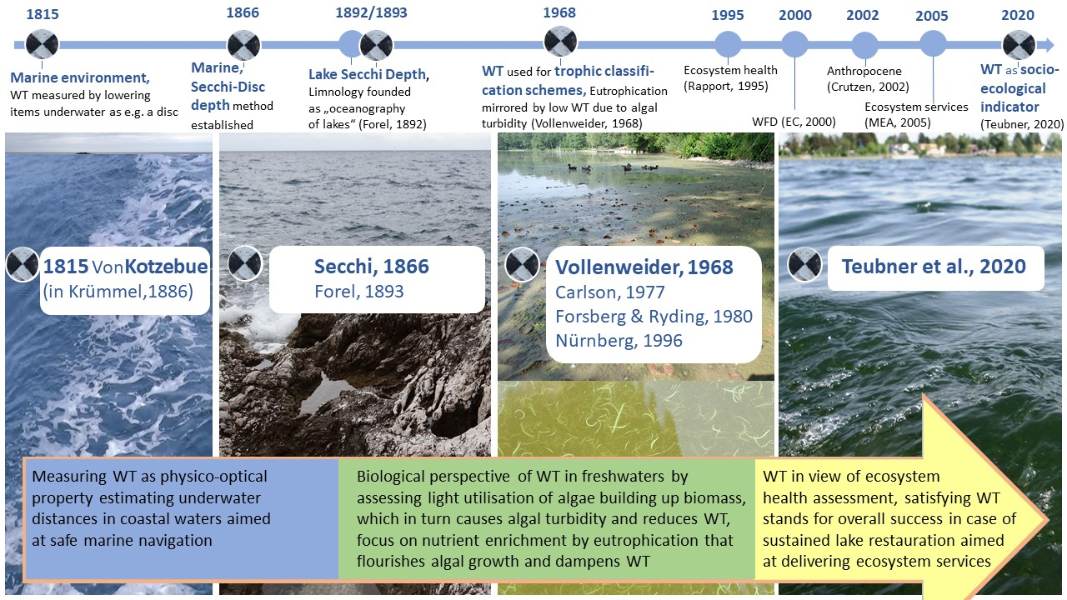
Univ.-Doz. Dr. Katrin Teubner www.lakeriver.at
from: Teubner et al. 2021, extended abstract, 43rd IAD-conference

Slide 10
Univ.-Doz. Dr. Katrin Teubner www.lakeriver.at
1.
2.
3.
from: Teubner et al. 2021, extended abstract, 43th IAD-conference

Slide 11
Response to (algal) turbidity
Stimulation for macrophyte growth
Secchi Disk Transparency
Secchi Disk Transparency
Univ.-Doz. Dr. Katrin Teubner www.lakeriver.at
The two sides of a coin
The two sides of a coin
43rd IAD-conference, June 2021

Slide 12
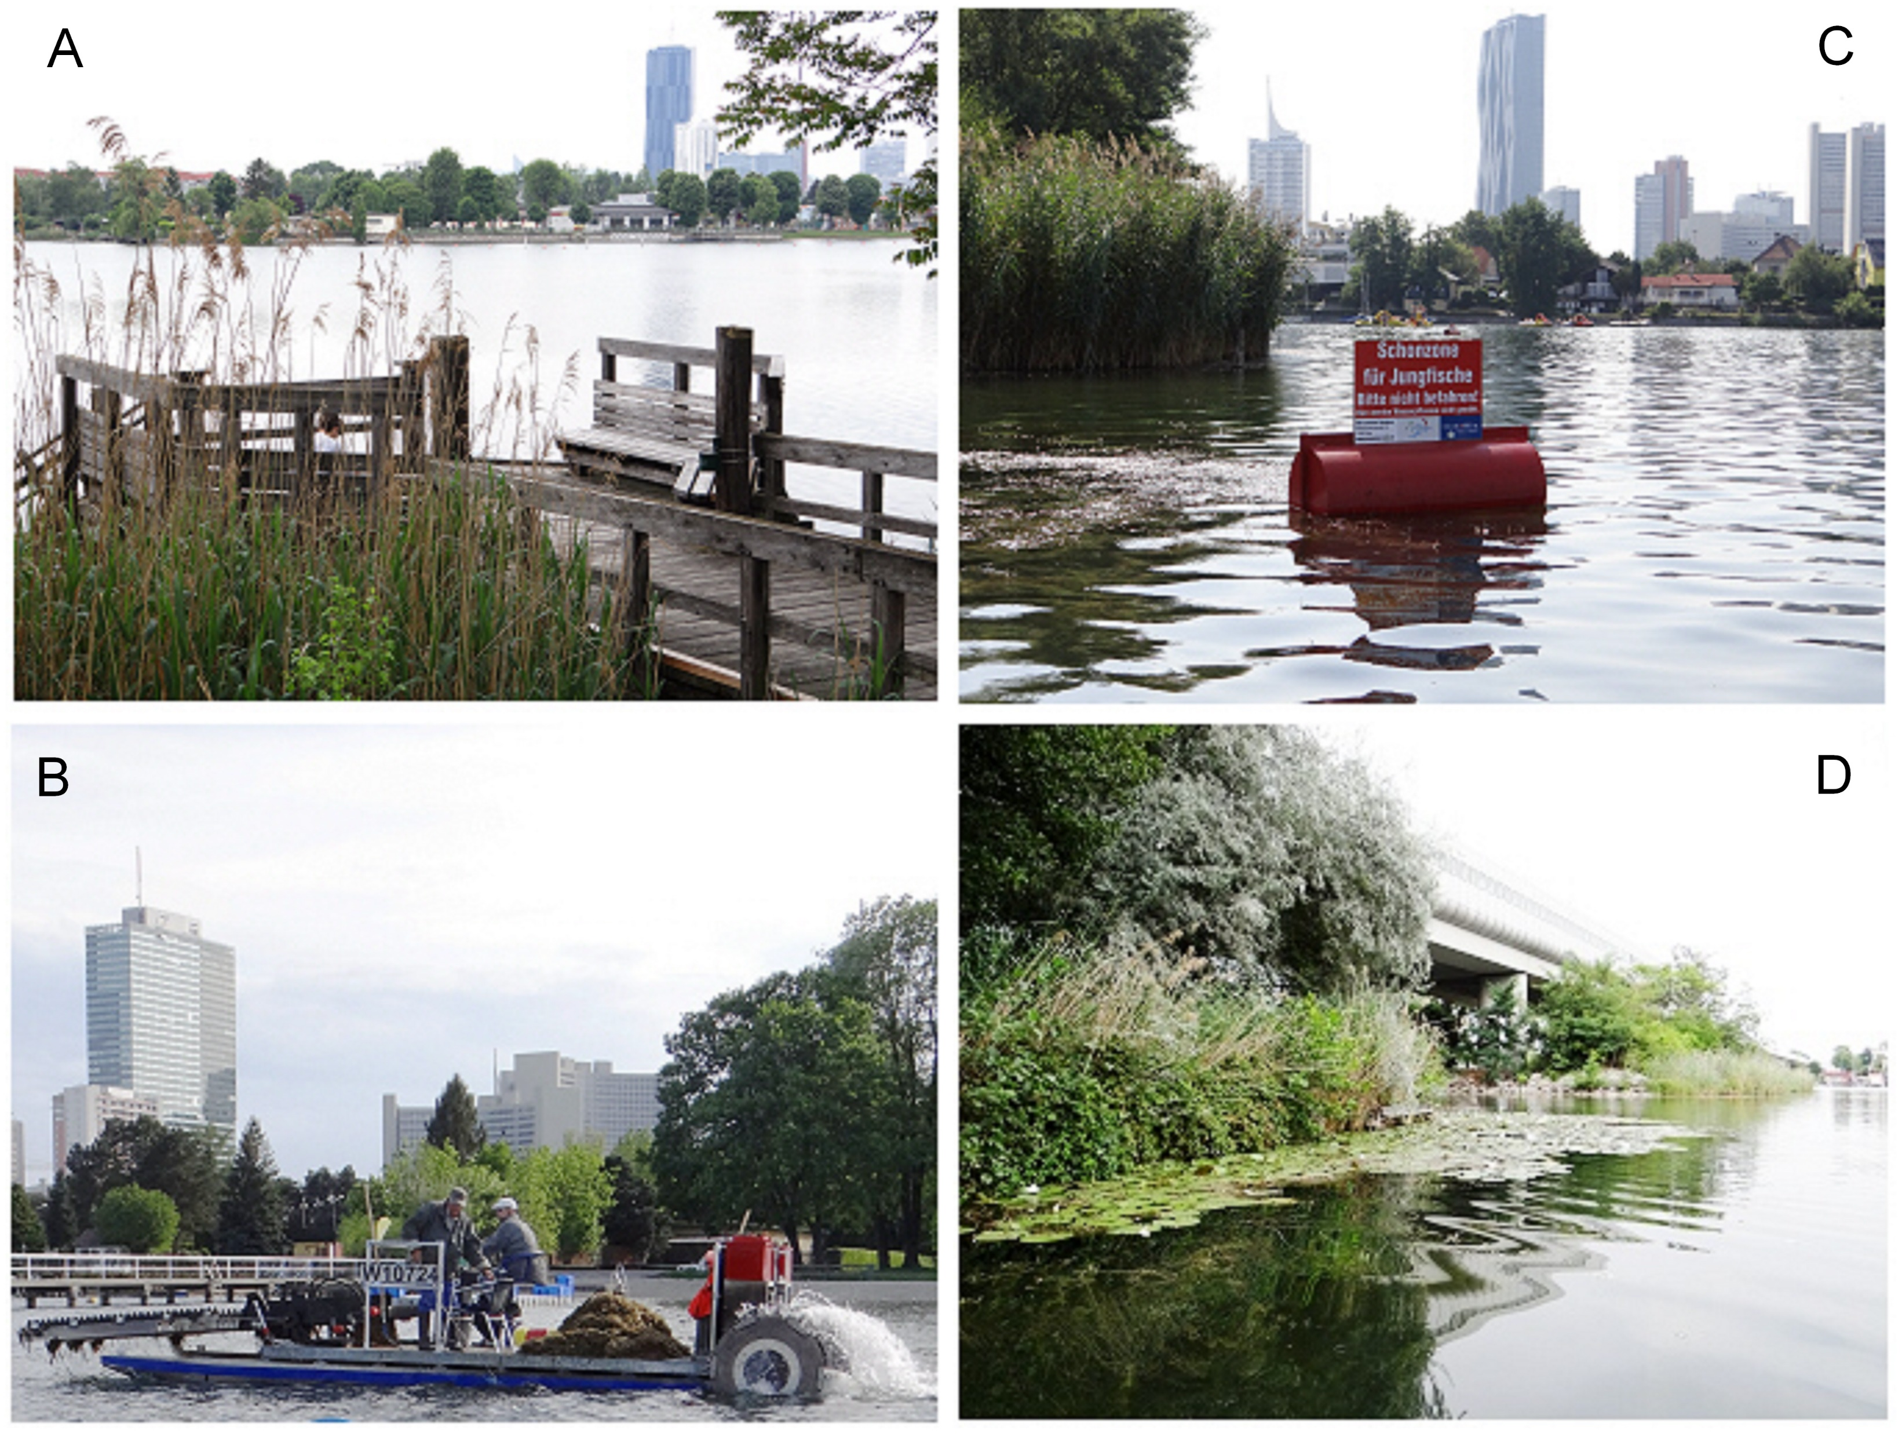
Response to (algal) turbidity
Stimulation for macrophyte growth
Univ.-Doz. Dr. Katrin Teubner www.lakeriver.at
Case study: Oxbow Lake Alte Donau, Vienna
43rd IAD-conference, June 2021

Slide 13
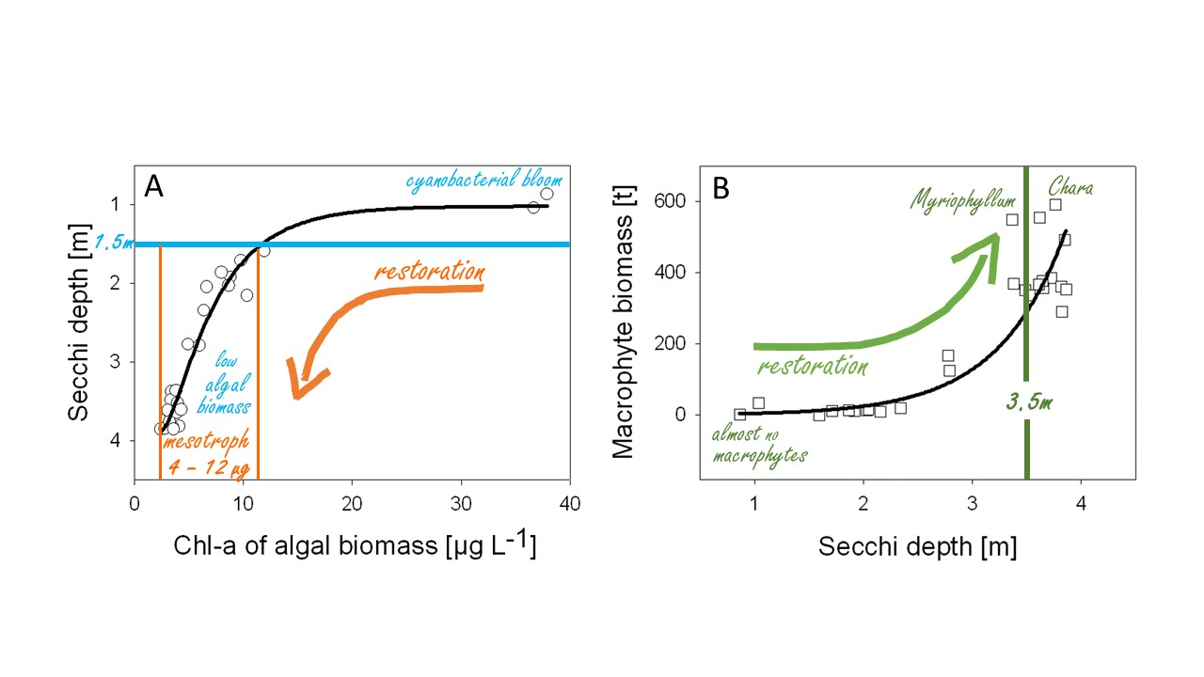
Response to (algal) turbidity
Stimulation for macrophyte growth
Univ.-Doz. Dr. Katrin Teubner www.lakeriver.at
from: Teubner et al. 2021, extended abstract, 43rd IAD-conference

Slide 14
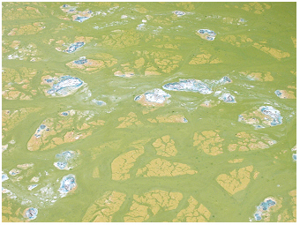
Response to (algal) turbidity
1.5 m Secchi depth = critical point
Univ.-Doz. Dr. Katrin Teubner www.lakeriver.at
from: Teubner et al. 2021, extended abstract, 43rd IAD-conference

Slide 15
Response to (algal) turbidity
1.5 m Secchi depth = critical point
shift from eutr. to mesotrophic state
judged as good water quality,
satisfying bathing aesthetics
by human perception,
Why?
Univ.-Doz. Dr. Katrin Teubner www.lakeriver.at
Photo: K Teubner
from: Teubner et al. 2021, extended abstract, 43rd IAD-conference

Slide 16
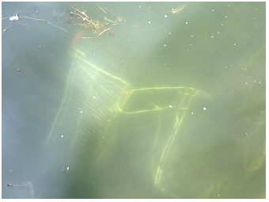
Response to (algal) turbidity
1.5 m Secchi depth = critical point
shift from eutr. to mesotrophic state
judged as good water quality,
satisfying bathing aesthetics
by human perception,
littoral “lake bottom view”
Univ.-Doz. Dr. Katrin Teubner www.lakeriver.at
Photo: K Teubner
from: Teubner et al. 2021, extended abstract, 43rd IAD-conference

Slide 17
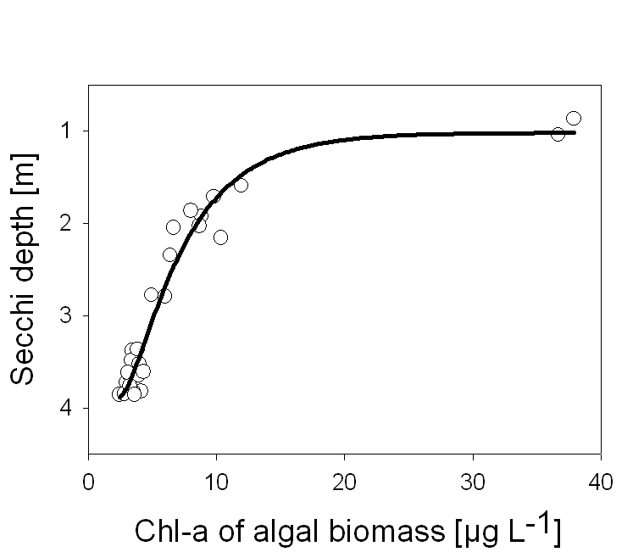
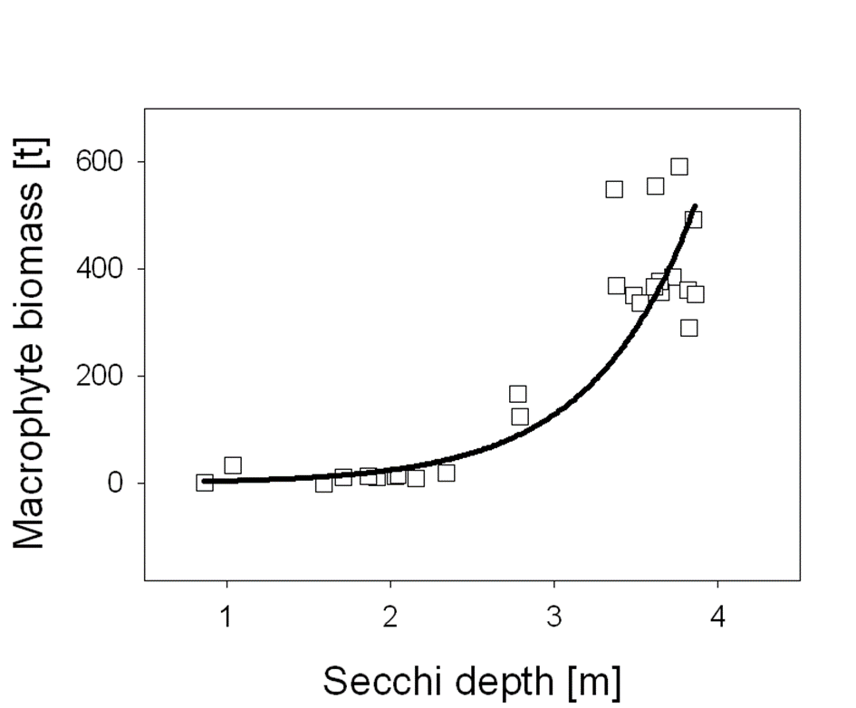
Response to (algal) turbidity
Stimulation for macrophyte growth
A
cyanobacterial bloom
B
Chara
Myriophyllum
1.5m
restoration
Univ.-Doz. Dr. Katrin Teubner www.lakeriver.at
low
restoration
algal
biomass
3.5m
mesotroph
almost no
4 – 12 µg
macrophytes
from: Teubner et al. 2021, extended abstract, 43rd IAD-conference

Slide 18
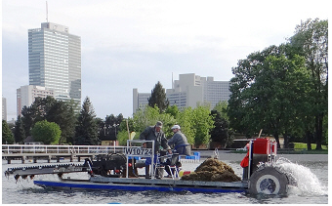
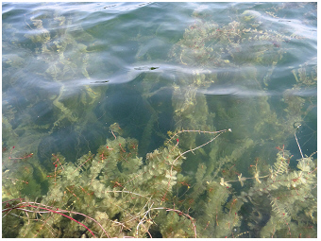
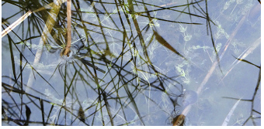
Stimulation for macrophyte growth
Underwater macrophyte cutting
Myriophyllum spicatum – tall
growing plant with canopy
near water surface
Photo: K Teubner
Univ.-Doz. Dr. Katrin Teubner www.lakeriver.at
Photo: K Teubner
Chara spec. – bottom
dwelling Charophytes
Photo: K Teubner
Photo: K Teubner
43rd IAD-conference, June 2021

Slide 19
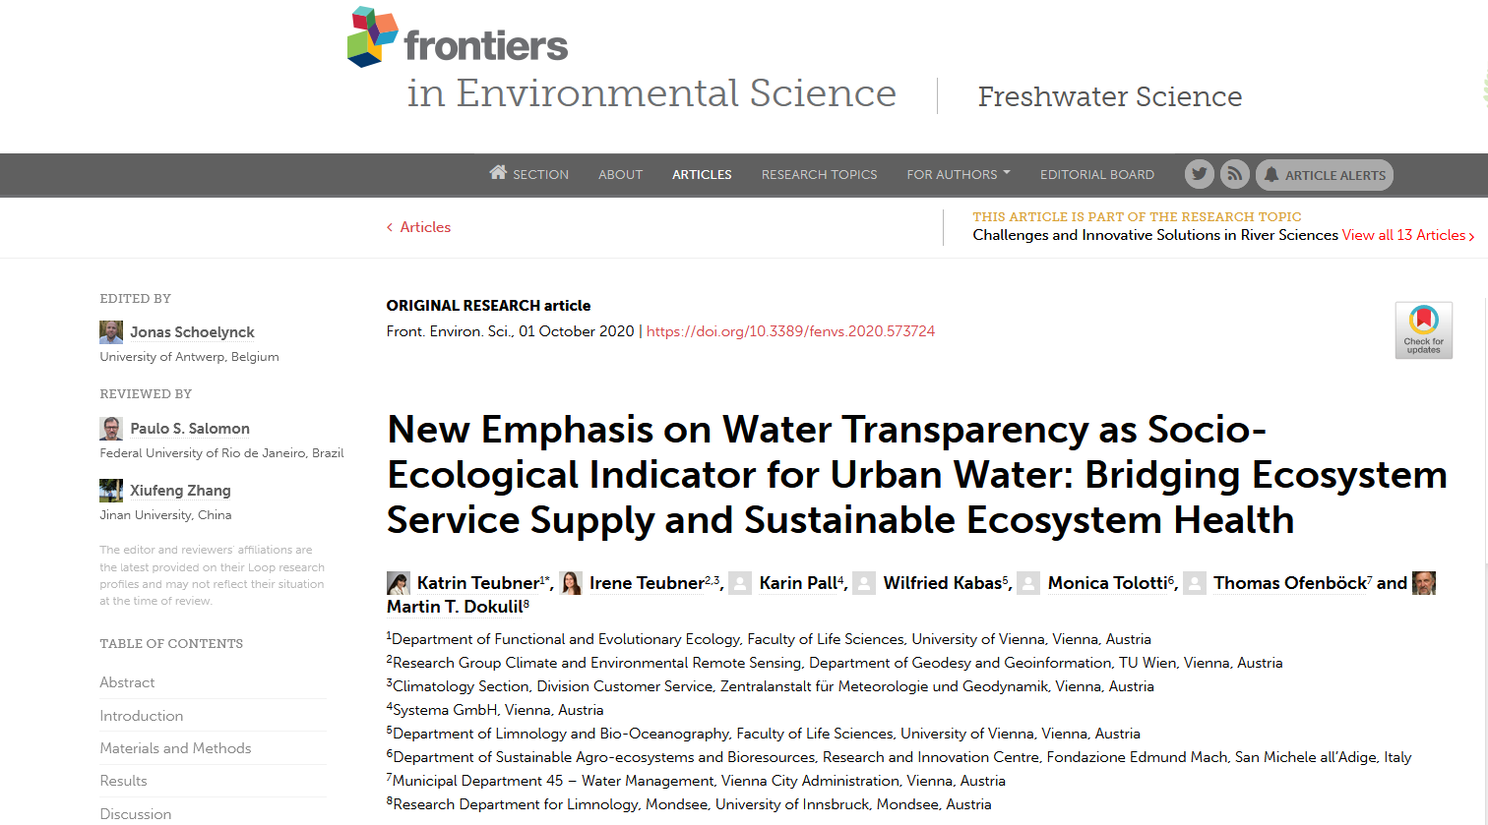
Univ.-Doz. Dr. Katrin Teubner www.lakeriver.at
Teubner et a. (2020). New Emphasis on Water Transparency as Socio-Ecological Indicator for Urban Water: Bridging Ecosystem Service Supply and
Sustainable Ecosystem Health. Frontiers in Environmental Science, 8, 162. https://www.frontiersin.org/articles/10.3389/fenvs.2020.573724/full

Slide 20
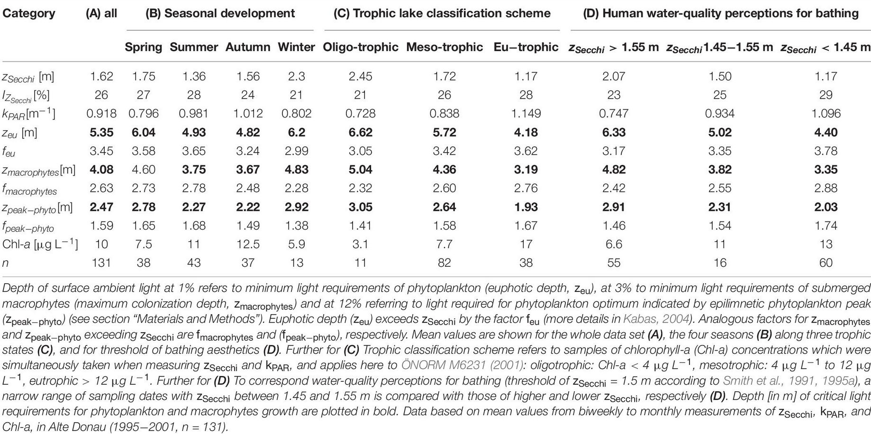
Univ.-Doz. Dr. Katrin Teubner www.lakeriver.at
Teubner et a. (2020). New Emphasis on Water Transparency as Socio-Ecological Indicator for Urban Water: Bridging Ecosystem Service Supply and
Sustainable Ecosystem Health. Frontiers in Environmental Science, 8, 162. https://www.frontiersin.org/articles/10.3389/fenvs.2020.573724/full

Slide 21
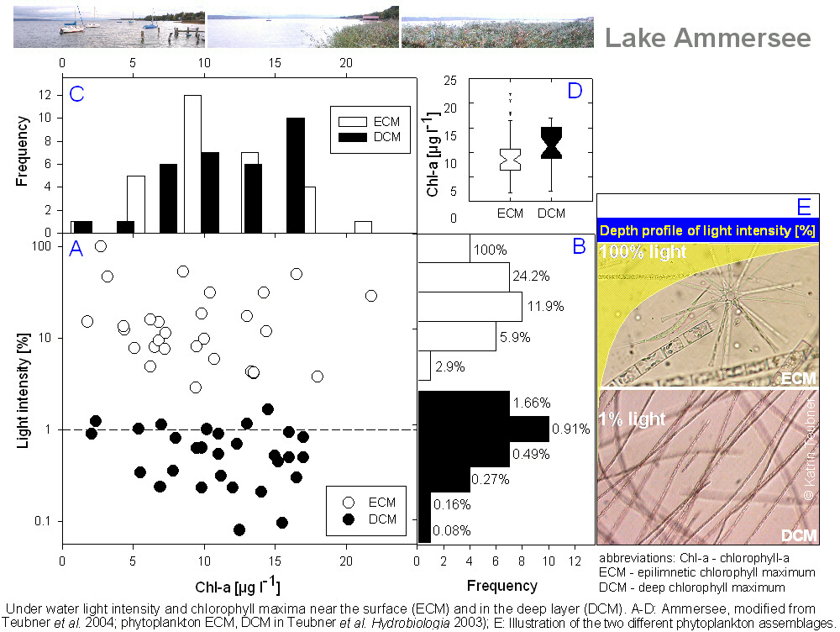
Univ.-Doz. Dr. Katrin Teubner www.lakeriver.at
Figure from: www.lakeriver.at
43rd IAD-conference, June 2021

Slide 22
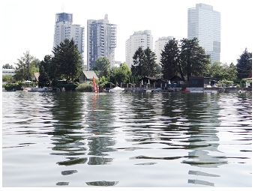
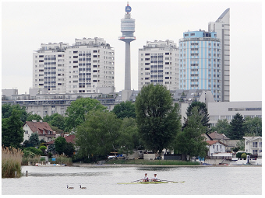
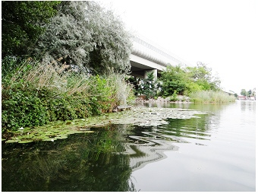
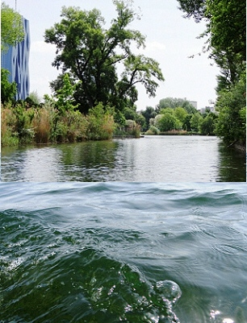
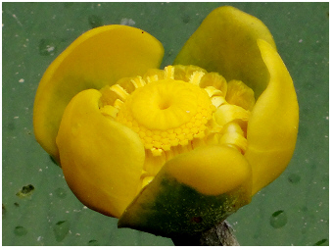
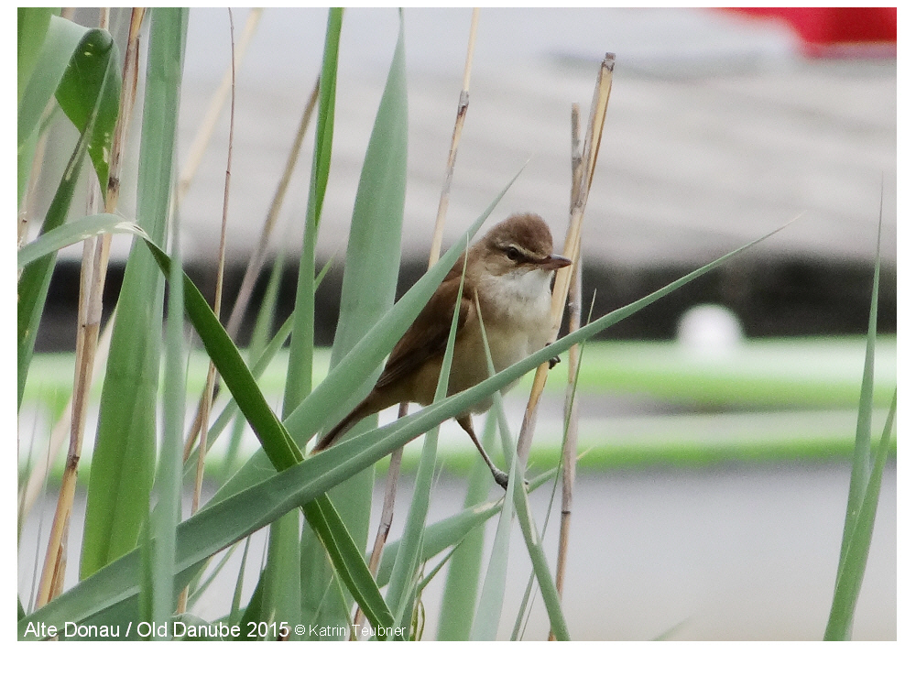
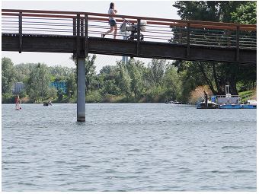
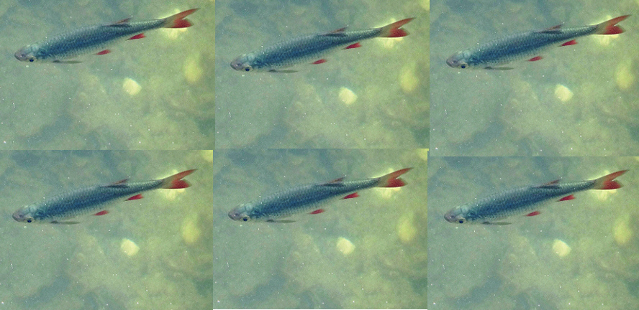
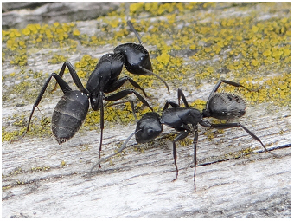
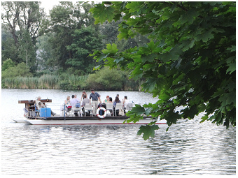
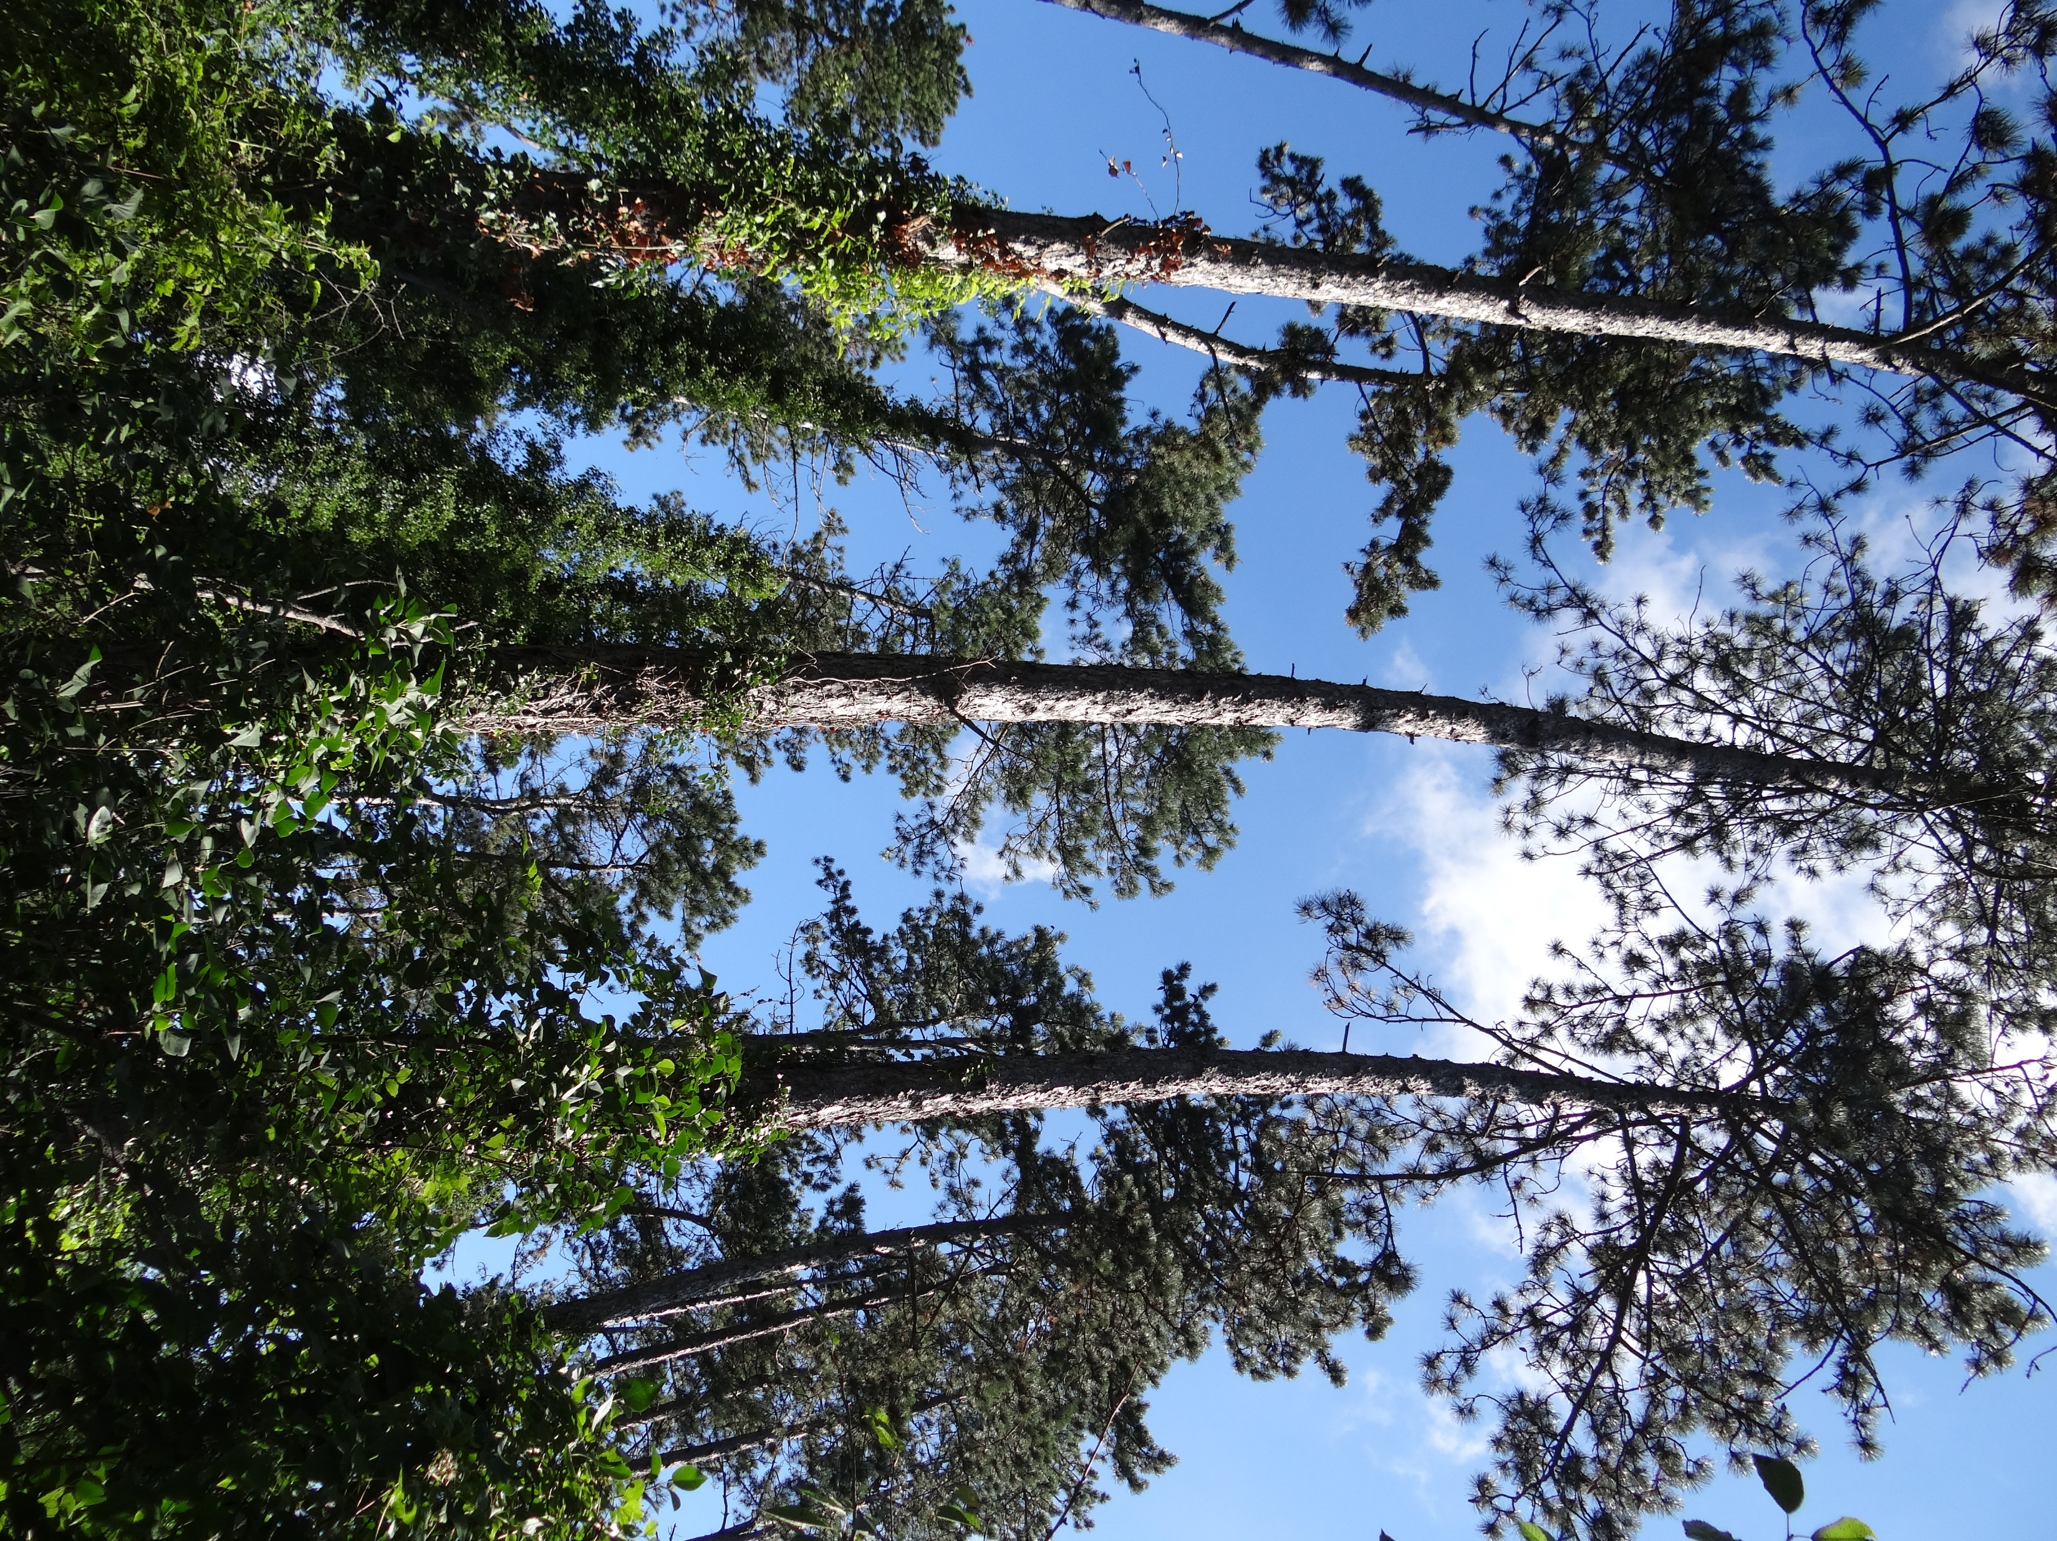
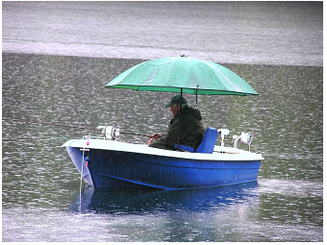
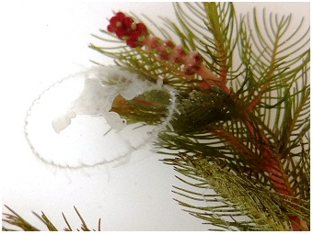
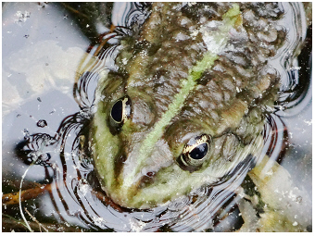
from: Teubner et al. 2021, extended abstract, 43rd IAD-conference
Water Transparency
= socio-ecological indicator
in urban blue space
Ecosystem Services Ecosystem Health
public awareness
strengthen of
ecosystem
to protect
functioning
Univ.-Doz. Dr. Katrin Teubner www.lakeriver.at
urban nature
Secchi depth:
> 1.5m
Mesotrophic state, suppression
> 3.5m
Sustained macrophyte growth,
Secchi depth:
> 1.5m
(„lake bottom view“)
Bathing & Swimming
of cyanobacterial blooms
mainly of bottom-dwelling Chara
human perception
reference ecosystem
high water clarity
about healthy environment
with high habitat structure & biodiversity

Slide 23
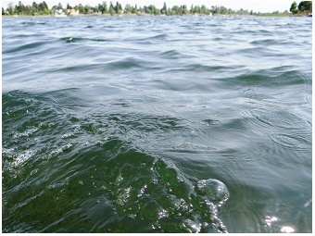
In conclusion:
Water transparency is identified as a key parameter which is important far beyond how we see it in limnology. It is the only parameter that the public can use by human perception for assessing the water quality or the progress of a lake restoration. In turn, a good status of water transparency close to ecosystem reference conditions attracts public awareness to take advantage of various ecosystem services enhancing well-being in urban life. In this view "green-blue” spaces are ranked higher for a better quality-of-life in cities than "green” spaces.
43rd IAD-conference, June 2021
Univ.-Doz. Dr. Katrin Teubner www.lakeriver.at
Thanks for your attention!

Slide 24
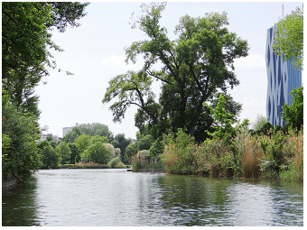
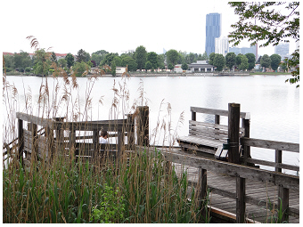
In conclusion:
Water transparency is identified as a key parameter which is important far beyond how we see it in limnology. It is the only parameter that the public can use by human perception for assessing the water quality or the progress of a lake restoration. In turn, a good status of water transparency close to ecosystem reference conditions attracts public awareness to take advantage of various ecosystem services enhancing well-being in urban life. In this view "green-blue” spaces are ranked higher for a better quality-of-life in cities than "green” spaces.
43rd IAD-conference, June 2021
Univ.-Doz. Dr. Katrin Teubner www.lakeriver.at
Thanks for your attention!

Slide 25
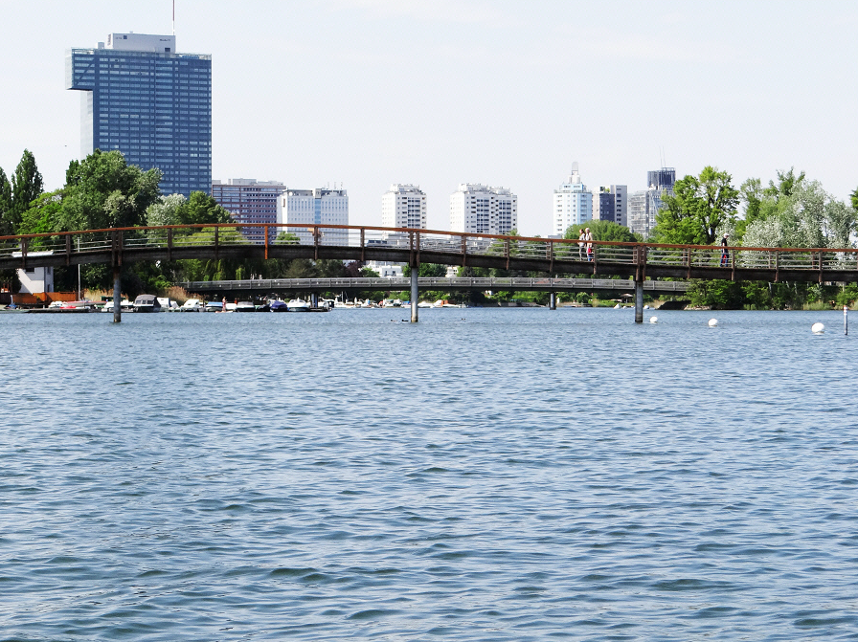
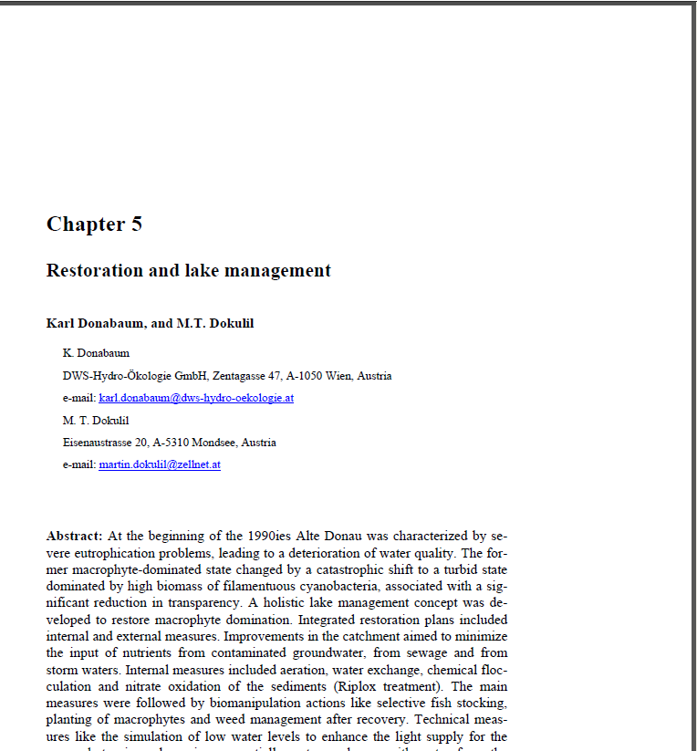

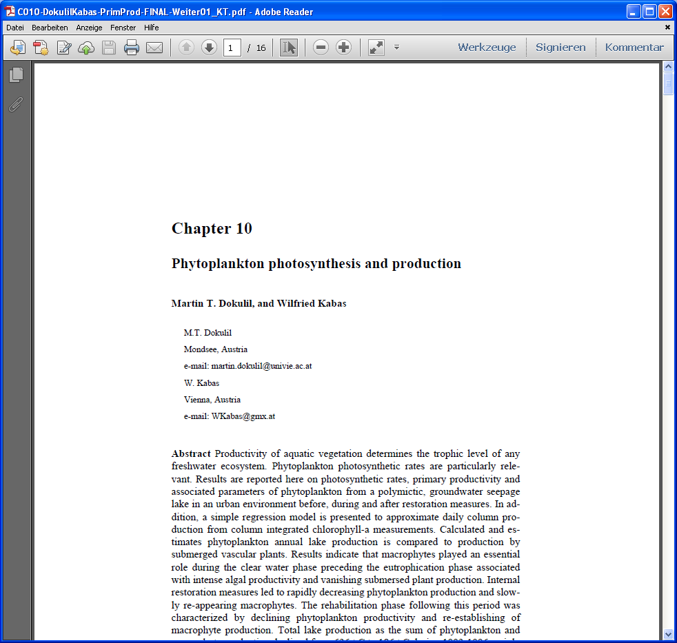
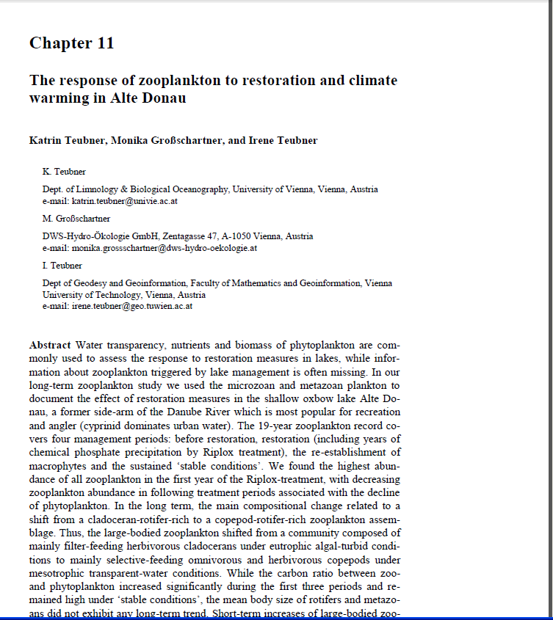


Katrin Teubner
Katrin Teubner
Book about restoration
& management of Alte Donau
Dokulil MT, Donabaum K,
Teubner K (Eds). (2018).
The Alte Donau: successful
restoration and sustainable
management: an ecosystem
case study of a shallow
urban lake (Vol. 10). Springer.
Univ.-Doz. Dr. Katrin Teubner www.lakeriver.at
43rd IAD-conference, June 2021

Slide 26
Katrin Teubner
Katrin Teubner
Katrin Teubner
Book about restoration
& management of Alte Donau
Dokulil MT, Donabaum K,
Teubner K (Eds). (2018).
The Alte Donau: successful
restoration and sustainable
management: an ecosystem
case study of a shallow
urban lake (Vol. 10). Springer.
Univ.-Doz. Dr. Katrin Teubner www.lakeriver.at
eds: Martin T. Dokulil, Karl Donabaum & Katrin Teubner


20
43rd IAD-conference, June 2021

Slide 27
Katrin Teubner
Katrin Teubner
Katrin Teubner
Book about restoration
& management of Alte Donau
Dokulil MT, Donabaum K,
Teubner K (Eds). (2018).
The Alte Donau: successful
restoration and sustainable
management: an ecosystem
case study of a shallow
urban lake (Vol. 10). Springer.
Univ.-Doz. Dr. Katrin Teubner www.lakeriver.at
43rd IAD-conference, June 2021

Slide 28

Univ.-Doz. Dr. Katrin Teubner www.lakeriver.at
Alte Donau, urban oxbow lake, Vienna
photo from: www.lakeriver.at

Slide 29

Univ.-Doz. Dr. Katrin Teubner www.lakeriver.at
Alte Donau, urban oxbow lake, Vienna
photo from: www.lakeriver.at

Slide 30

Univ.-Doz. Dr. Katrin Teubner www.lakeriver.at
Alte Donau, urban oxbow lake, Vienna
photo from: www.lakeriver.at

Slide 31

Univ.-Doz. Dr. Katrin Teubner www.lakeriver.at
Alte Donau, urban oxbow lake, Vienna
photo from: www.lakeriver.at

Slide 32

Univ.-Doz. Dr. Katrin Teubner www.lakeriver.at
Alte Donau, urban oxbow lake, Vienna
photo from: www.lakeriver.at

Slide 33
Univ.-Doz. Dr. Katrin Teubner www.lakeriver.at
Alte Donau, urban oxbow lake, Vienna
photo from: www.lakeriver.at

Slide 34

Univ.-Doz. Dr. Katrin Teubner www.lakeriver.at
Alte Donau, urban oxbow lake, Vienna
photo from: www.lakeriver.at
43rd IAD-conference, June 2021

Slide 35



Univ.-Doz. Dr. Katrin Teubner www.lakeriver.at
Alte Donau, urban oxbow lake, Vienna
photo from: www.lakeriver.at

Slide 36

Univ.-Doz. Dr. Katrin Teubner www.lakeriver.at
Alte Donau, urban oxbow lake, Vienna
photo from: www.lakeriver.at

Slide 37
Univ.-Doz. Dr. Katrin Teubner www.lakeriver.at
Alte Donau, urban oxbow lake, Vienna
photo from: www.lakeriver.at

Slide 38

Univ.-Doz. Dr. Katrin Teubner www.lakeriver.at
Alte Donau, urban oxbow lake, Vienna
photo from: www.lakeriver.at

Slide 39

Univ.-Doz. Dr. Katrin Teubner www.lakeriver.at
Alte Donau, urban oxbow lake, Vienna
photo from: www.lakeriver.at

Slide 40

Univ.-Doz. Dr. Katrin Teubner www.lakeriver.at
Alte Donau, urban oxbow lake, Vienna
photo from: www.lakeriver.at

Slide 41

Univ.-Doz. Dr. Katrin Teubner www.lakeriver.at
Alte Donau, urban oxbow lake, Vienna
photo from: www.lakeriver.at

Slide 42

Univ.-Doz. Dr. Katrin Teubner www.lakeriver.at
Alte Donau, urban oxbow lake, Vienna
photo from: www.lakeriver.at

